Slide 1
COMPLETE
BUSINESS
STATISTICS
by
AMIR D. ACZEL
&
JAYAVEL SOUNDERPANDIAN
7th edition.
Prepared by Lloyd Jaisingh, Morehead State University
Chapter 16
Sampling Methods
McGraw-Hill/Irwin
Copyright © 2009 by The McGraw-Hill Companies, Inc. All rights reserved.

Slide 2
_{16-<number>}
16
Sampling Methods
Using Statistics
Nonprobability Sampling and Bias
Stratified Random Sampling
Cluster Sampling
Systematic Sampling
Nonresponse

Slide 3
_{16-<number>}
16
LEARNING OBJECTIVES
After studying this chapter you should be able to:
Apply nonprobability sampling methods
Decide when to conduct a stratified sampling method
Compute estimates from stratified sample results
Decide when to conduct a cluster sampling method

Slide 4
_{16-<number>}
16
LEARNING OBJECTIVES (2)
After studying this chapter you should be able to:
Compute estimates from cluster sampling results
Decide when to conduct a systematic sampling method
Compute estimates from systematic sample results
Avoid nonresponse biases in estimates

Slide 5
16-2 Nonprobability Sampling and Bias
_{16-<number>}
Sampling methods that do not use samples with known probabilities of selection are know as nonprobability sampling methods.
In nonprobability sampling methods, there is no objective way of evaluating how far away from the population parameter the estimate may be.
Frame - a list of people or things of interest from which a random sample can be chosen.

Slide 6







16-3 Stratified Random Sampling
_{16-<number>}
In stratified random sampling, we assume that the population of N units may be divided into m groups with N_{i} units in each group i=1,2,...,m. The m strata are nonoverlapping and together they make up the total population: N₁ + N₂ +...+ N_{m} =N.
Population
The m strata are non-overlapping.

Slide 7
16-3 Stratified Random Sampling (Continued)
_{16-<number>}
In stratified random sampling, we assume that the population of N units may be divided into m groups with N_{i} units in each group i=1,2,...,m. The m strata are nonoverlapping and together they make up the total population: N₁ + N₂ +...+ N_{m} =N.
N_{i}
n_{i}
1
2
3
4
5
6
7
Group
1
2
3
4
5
6
7
Group
Population Distribution
Sample Distribution
In proportional allocation, the relative frequencies in the sample (n_{i}/n) are the same as those in the population (N_{i}/N) .

Slide 8
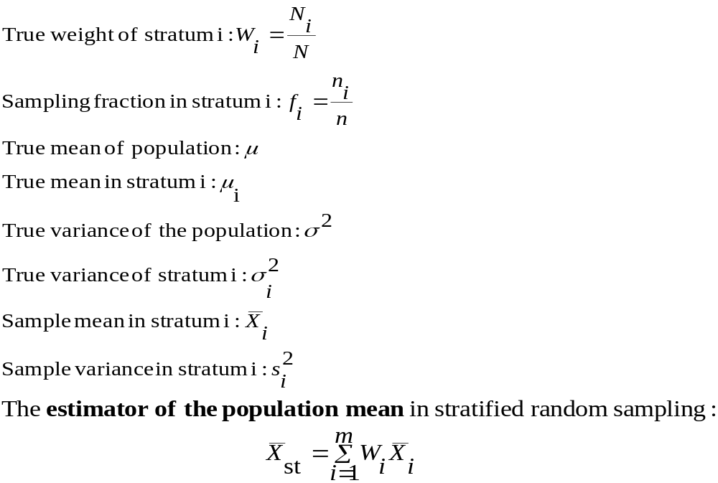
Relationship Between the Population and a Stratified Random Sample
_{16-<number>}

Slide 9
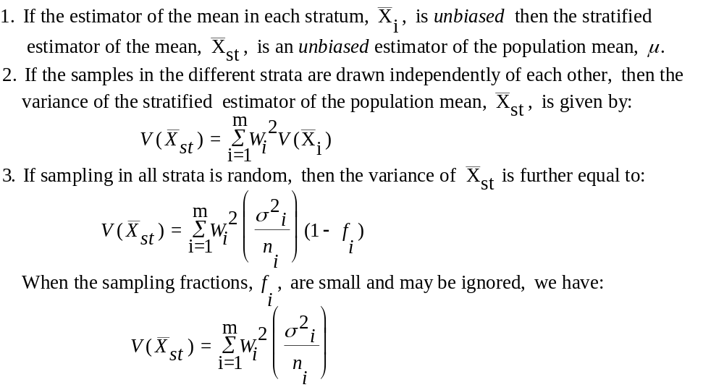
Properties of the Stratified Estimator of the Sample Mean
_{16-<number>}

Slide 10
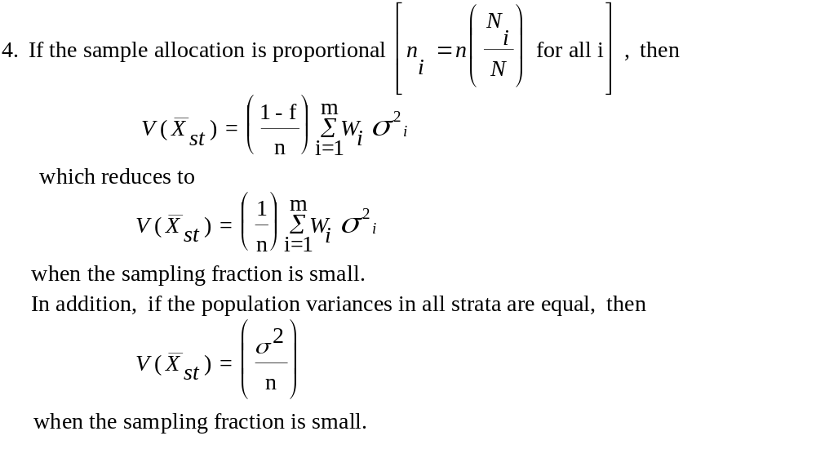
Properties of the Stratified Estimator of the Sample Mean (continued)
_{16-<number>}

Slide 11
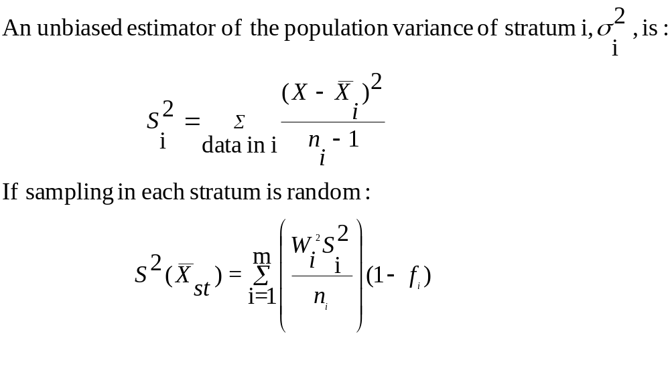
When the Population Variance is Unknown
_{16-<number>}

Slide 12
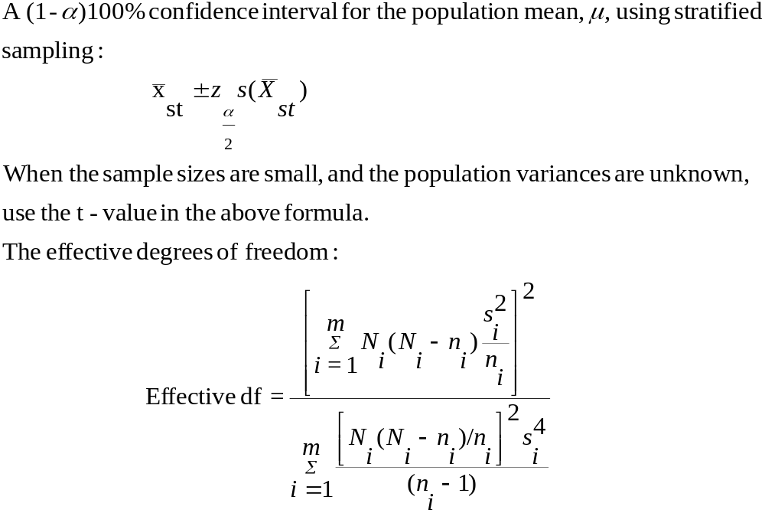
Confidence Interval for the Population Mean in Stratified Sampling
_{16-<number>}

Slide 13
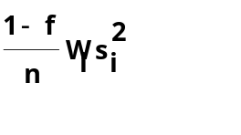
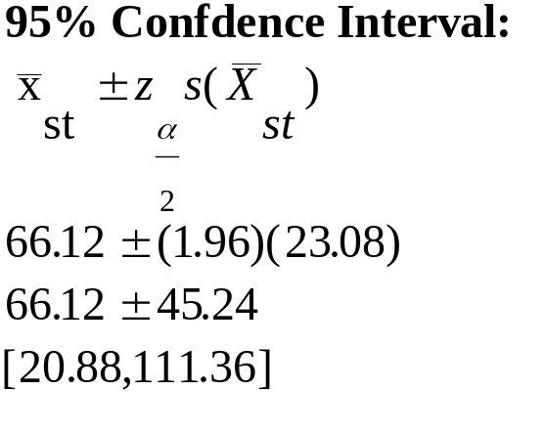
Example 16-2
_{16-<number>}
Population True Sampling
Number Weights Sample Fraction
Group of Firms (W_{i}) Sizes (f_{i})
1. Diversified service companies 100 0.20 20 0.20
2. Commercial banking companies 100 0.20 20 0.20
3. Financial service companies 150 0.30 30 0.30
4. Retailing companies 50 0.10 10 0.10
5. Transportation companies 50 0.10 10 0.10
6. Utilities 50 0.10 10 0.10
N = 500 n = 100
Stratum Mean Variance n_{i} W_{i} W_{i}x_{i}
1 52.7 97650 20 0.2 10.54 156.240
2 112.6 64300 20 0.2 22.52 102.880
3 85.6 76990 30 0.3 25.68 184.776
4 12.6 18320 10 0.1 1.26 14.656
5 8.9 9037 10 0.1 0.89 7.230
6 52.3 83500 10 0.1 5.23 66.800
Estimated Mean: 66.12 532.582
Estimated standard error of mean: 23.08

Slide 14
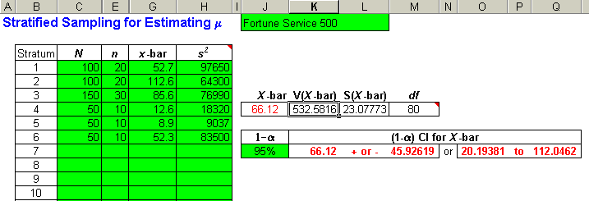
Example 16-2 Using the template
_{16-<number>}
Observe that the computer gives a slightly more precise interval than the hand computation on the previous slide.

Slide 15
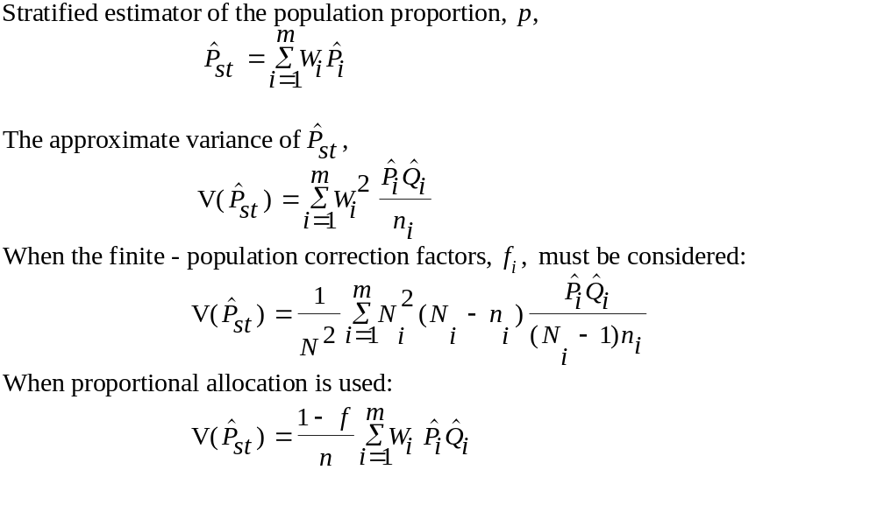
Stratified Sampling for the Population Proportion
_{16-<number>}

Slide 16
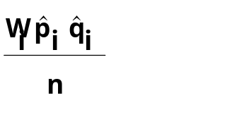
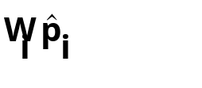
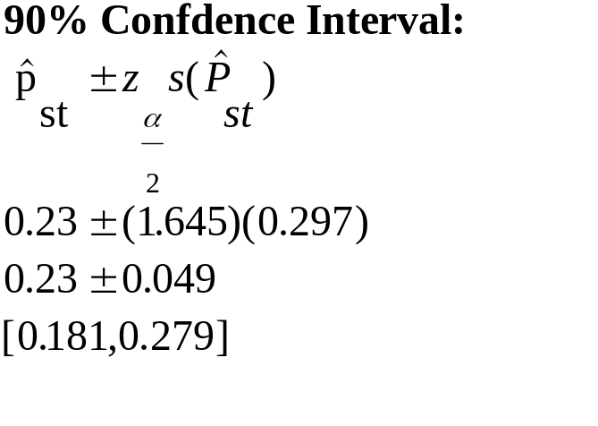
Stratified Sampling for the Population Proportion: Example 16-1 (Continued)
_{16-<number>}
Number
Group W_{i} n_{i} f_{i} Interested
Metropolitan 0.65 130 0.65 28 0.14 0.0005756
Nonmetropolitan 0.35 70 0.35 18 0.09 0.0003099
Estimated proportion: 0.23 0.0008855
Estimated standard error: 0.0297574
90% confidence interval:[ 0.181, 0.279]

Slide 17
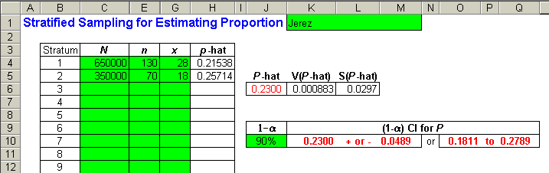
Stratified Sampling for the Population Proportion:Example 16-1 (Continued) using the Template
_{16-<number>}

Slide 18
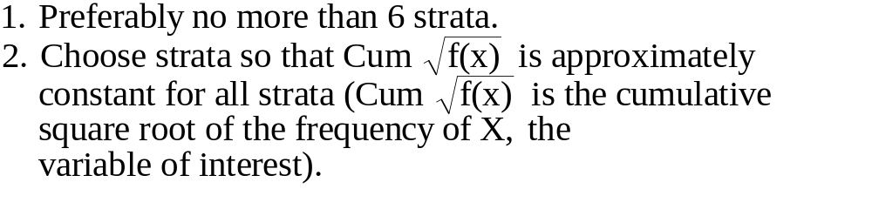


Rules for Constructing Strata
_{16-<number>}
Age Frequency (f_{i})
20-25 1 1
26-30 16 4 5
31-35 25 5 5
36-40 4 2
41-45 9 3 5

Slide 19
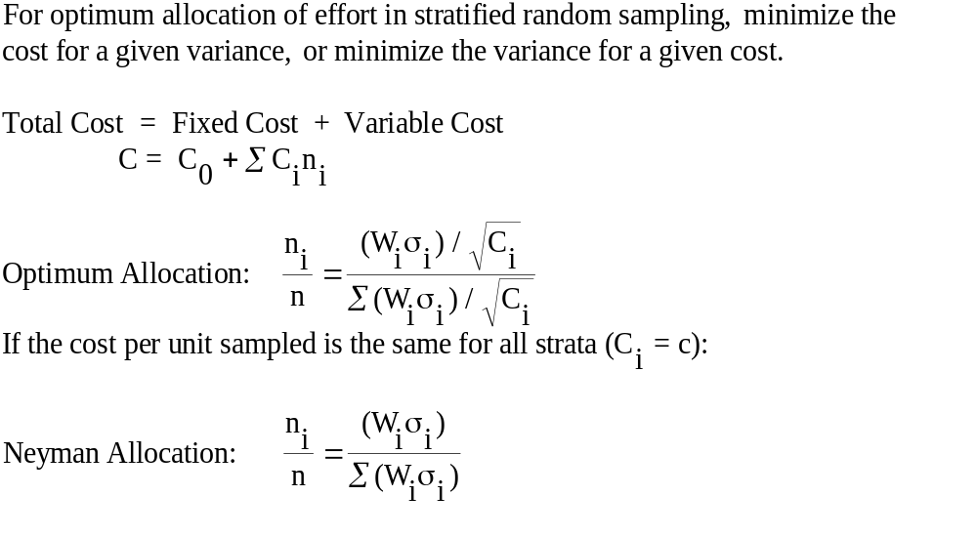
Optimum Allocation
_{16-<number>}

Slide 20
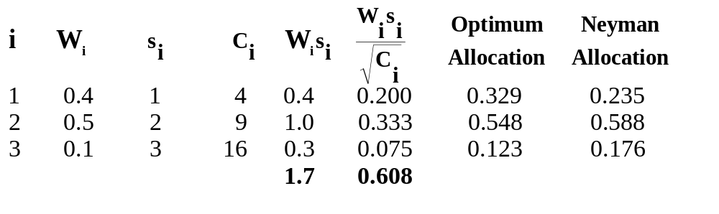
Optimum Allocation: An Example
_{16-<number>}

Slide 21
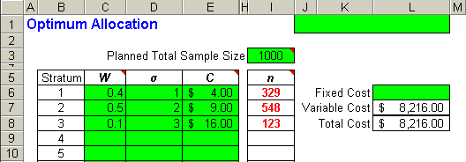
Optimum Allocation: An Example using the Template
_{16-<number>}

Slide 22
16-4 Cluster Sampling
_{16-<number>}
1
2
3
4
5
6
7
Group
Population Distribution
Sample Distribution
In stratified sampling a random sample (n_{i}) is chosen from each segment of the population (N_{i}).
In cluster sampling observations are drawn from m out of M areas or clusters of the population.

Slide 23
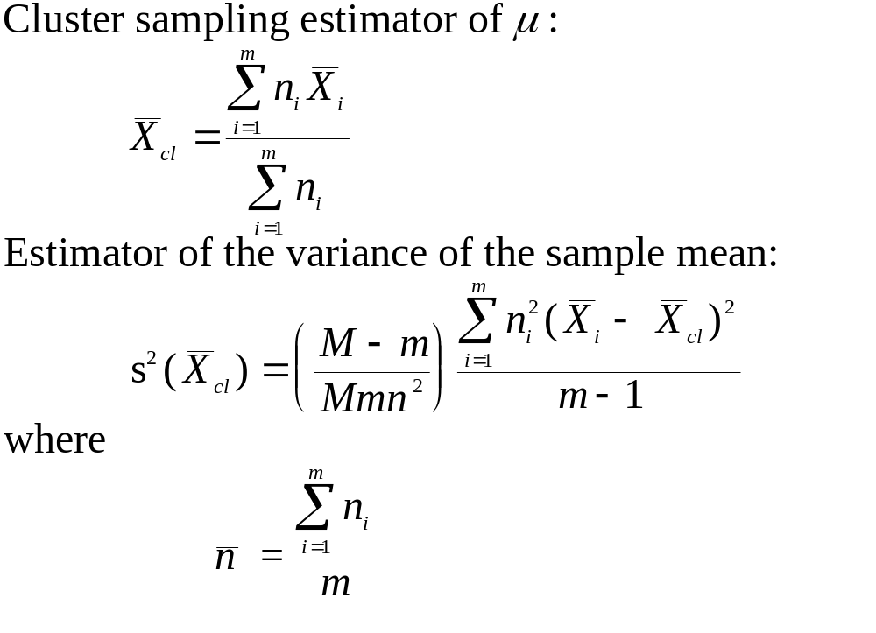
Cluster Sampling: Estimating the Population Mean
_{16-<number>}

Slide 24
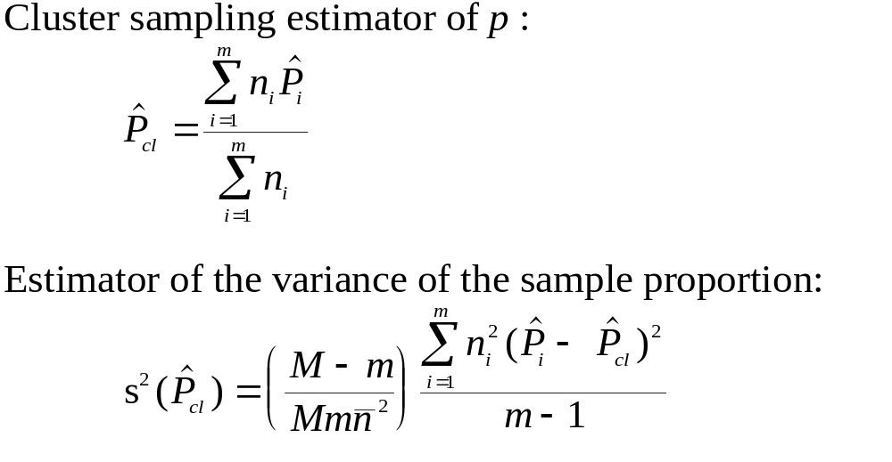
Cluster Sampling: Estimating the Population Proportion
_{16-<number>}

Slide 25
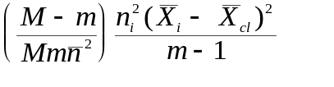
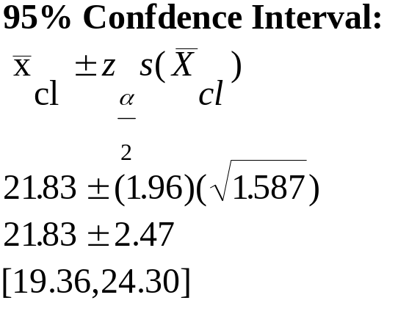
Cluster Sampling: Example 16-3
_{16-<number>}
x_{i} n_{i} n_{i}x_{i} x_{i}-x_{cl} (x_{i}-x_{cl})²
21 8 168 -0.8333 0.694 0.00118
22 8 176 0.1667 0.028 0.00005
11 9 99 -10.8333 117.361 0.25269
34 10 340 12.1667 148.028 0.39348
28 7 196 6.1667 38.028 0.04953
25 8 200 3.1667 10.028 0.01706
18 10 180 -3.8333 14.694 0.03906
24 12 288 2.1667 4.694 0.01797
19 11 209 -2.8333 8.028 0.02582
20 6 120 -1.8333 3.361 0.00322
30 8 240 8.1667 66.694 0.11346
26 9 234 4.1667 17.361 0.03738
12 9 108 -9.8333 96.694 0.20819
17 8 136 -4.8333 23.361 0.03974
13 10 130 -8.8333 78.028 0.20741
29 8 232 7.1667 51.361 0.08738
24 8 192 2.1667 4.694 0.00799
26 10 260 4.1667 17.361 0.04615
18 10 180 -3.8333 14.694 0.03906
22 11 242 0.1667 0.028 0.00009
3930 s²(X_{cl})= 1.58691
x_{cl} = 21.83

Slide 26
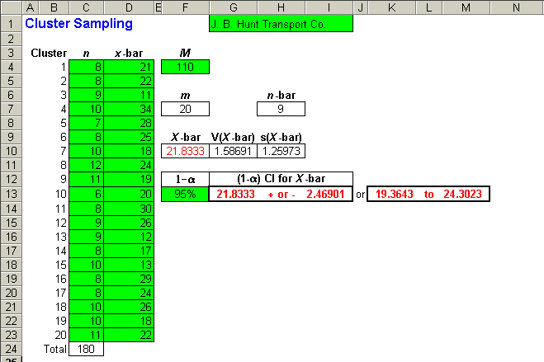
Cluster Sampling: Example 16-3 Using the Template
_{16-<number>}

Slide 27
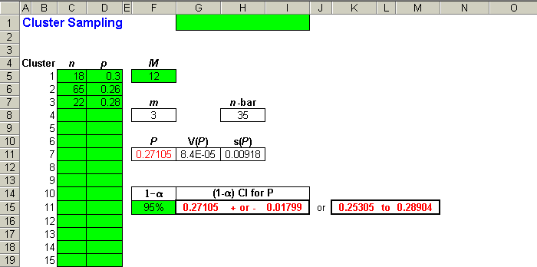
Cluster Sampling: Using the Template to Estimate Population Proportion
_{16-<number>}

Slide 28
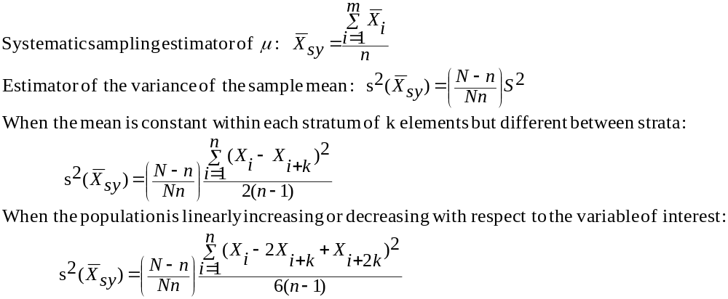
16-5 Systematic Sampling
_{16-<number>}
Randomly select an element out of the first k elements in the population, and then select every kth unit afterwards until we have a sample of n elements.

Slide 29
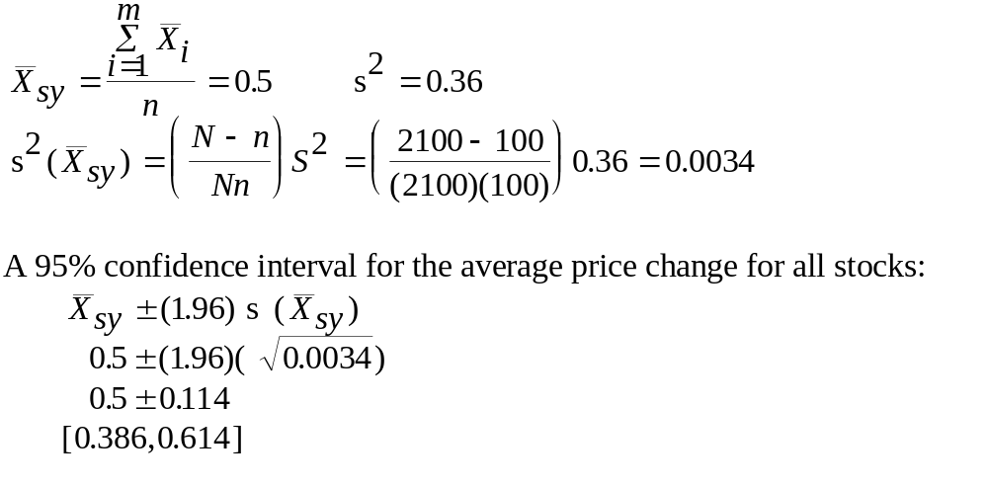
Systematic Sampling: Example 16-4
_{16-<number>}

Slide 30
16-6 Nonresponse
_{16-<number>}
Systematic nonresponse can bias estimates
  Callbacks of nonrespondents
  Offers of monetary rewards for nonrespondents
  Random-response mechanism

